Slide 1
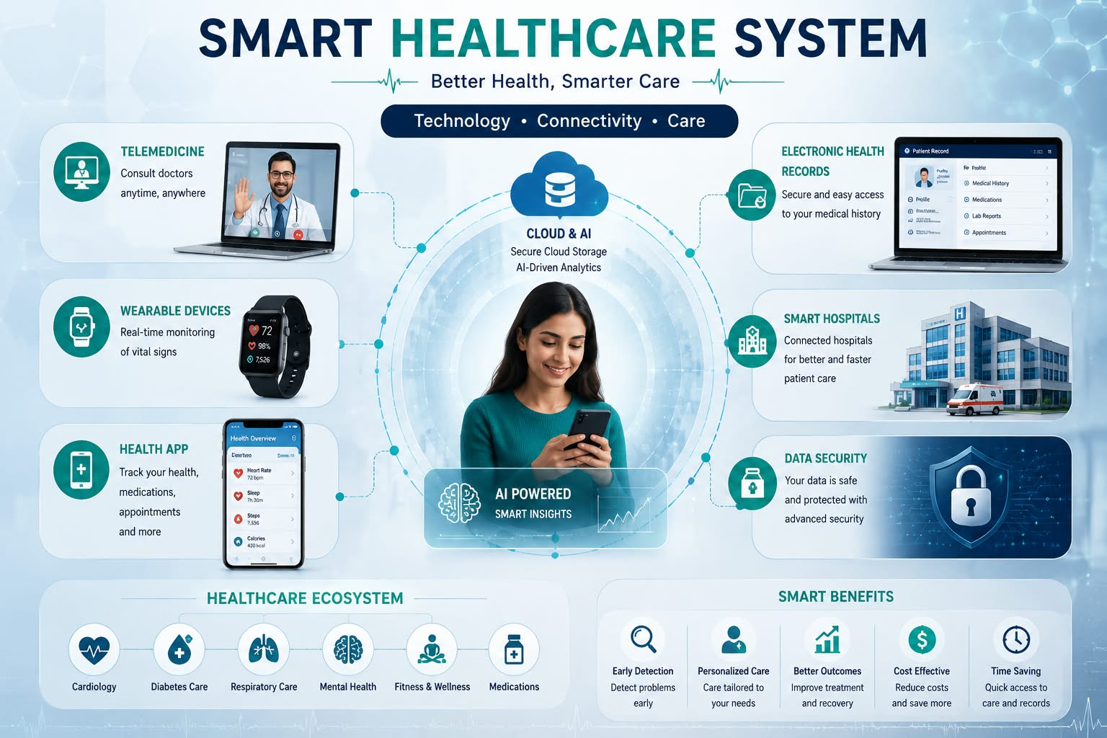
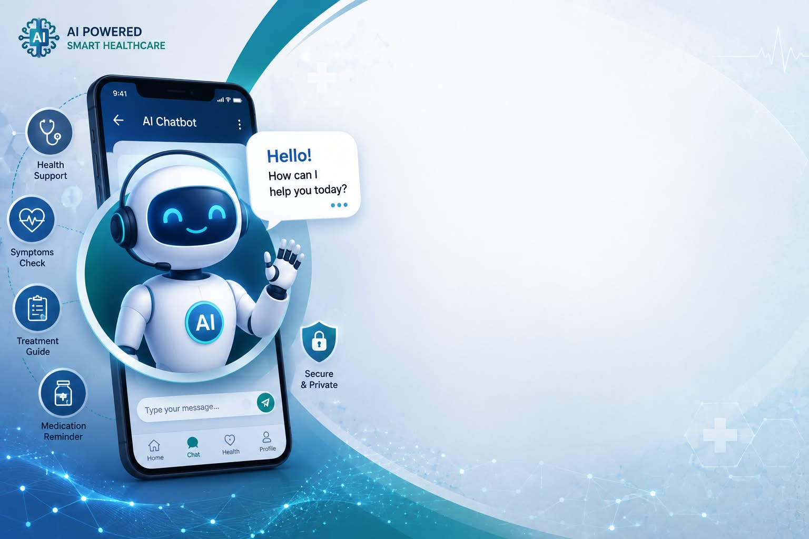
ALIBABA AI HACKATHON 2026
AI-Based Personalized Treatment Plan Generator
For Smart Healthcare Systems
Presented BY: Manahil Noor
[AI Assistant
Chatbot Image]
[Smart Healthcare
System Image]
AI Doctor Assistant
Patient Care Platform

Slide 2
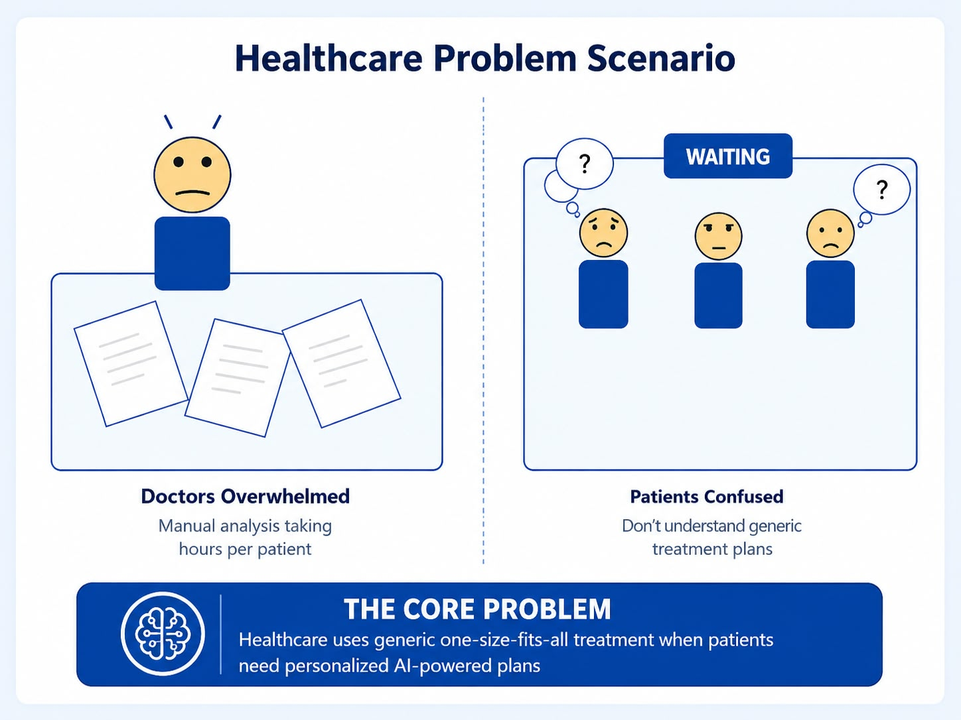
Problem Statement
Healthcare Challenge
Healthcare Challenge
Current healthcare systems face critical challenges:
- One-Size-Fits-All Treatment Protocols
Generic treatment plans don't account for individual patient differences
- Time-Consuming Manual Diagnosis
Doctors spend hours analyzing patient data manually
- Limited Patient Personalization
No AI-driven customization of treatment approaches
- Scalability Issues
High costs prevent personalized care from reaching remote populations
- Poor Treatment Adherence
Patients don't follow generic plans they don't understand
KEY INSIGHT:
Healthcare needs AI-powered personalization to deliver the right treatment
to the right patient at the right time
[Problem Scenario
Image]

Slide 3
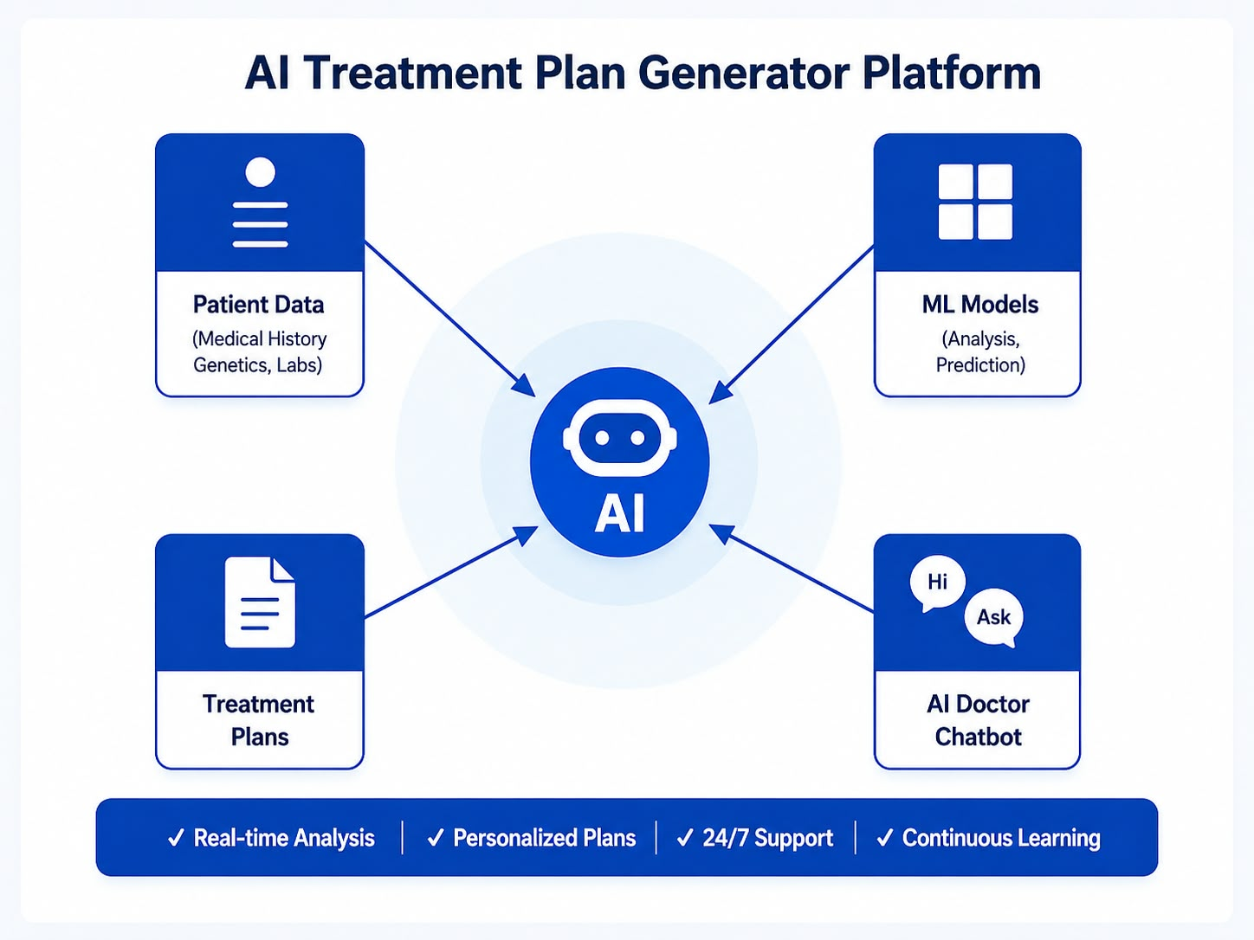
Our AI Solution
Innovation Track

Slide 4
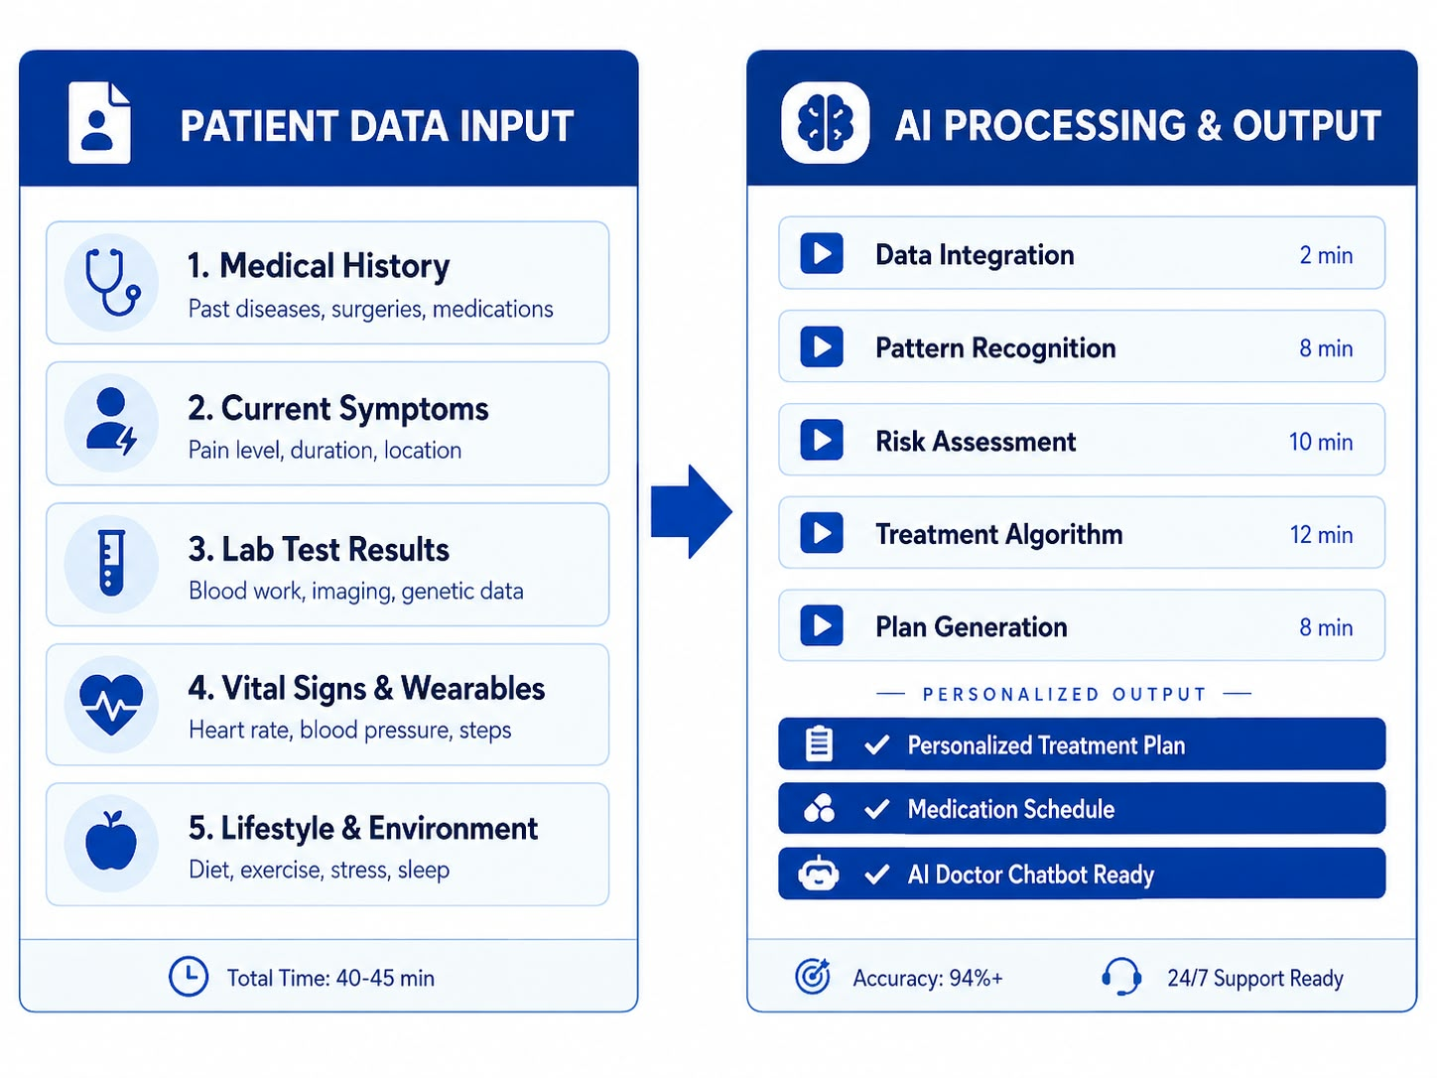
How It Works
System Architecture
[Patient Data
Input Process]
[AI Processing &
Analysis Flow]

Slide 5
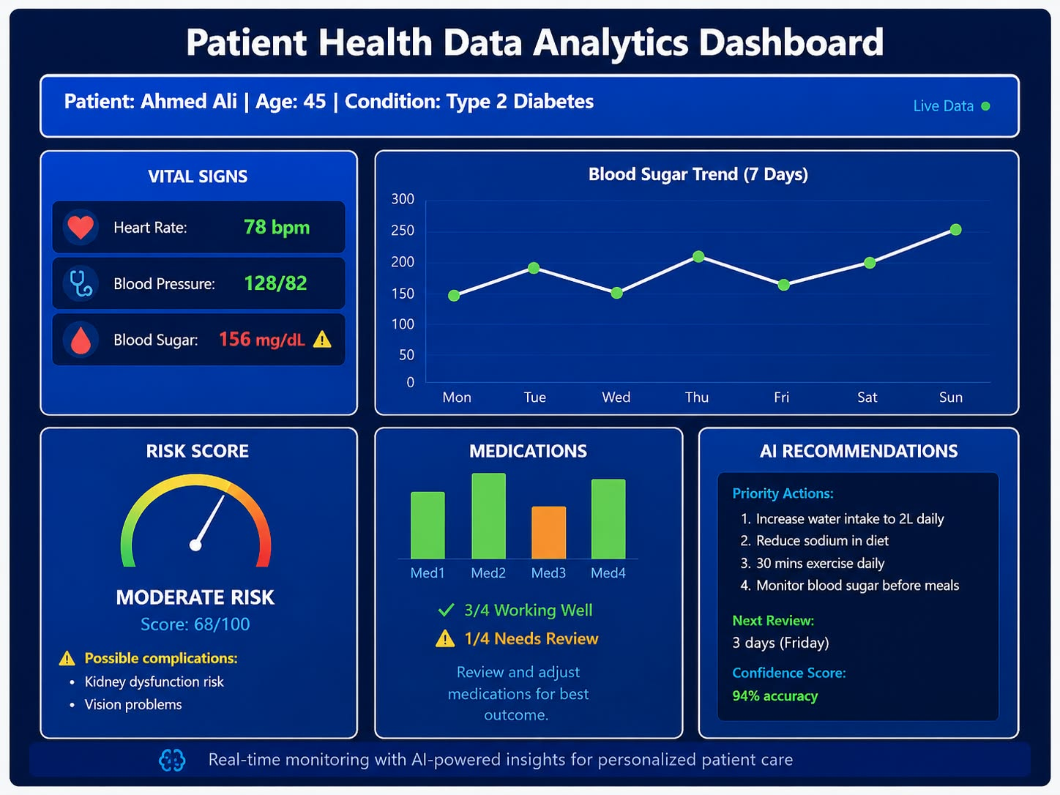
Patient Data Analysis
Data Processing
[Patient Health Data
Analytics Dashboard]

Slide 6
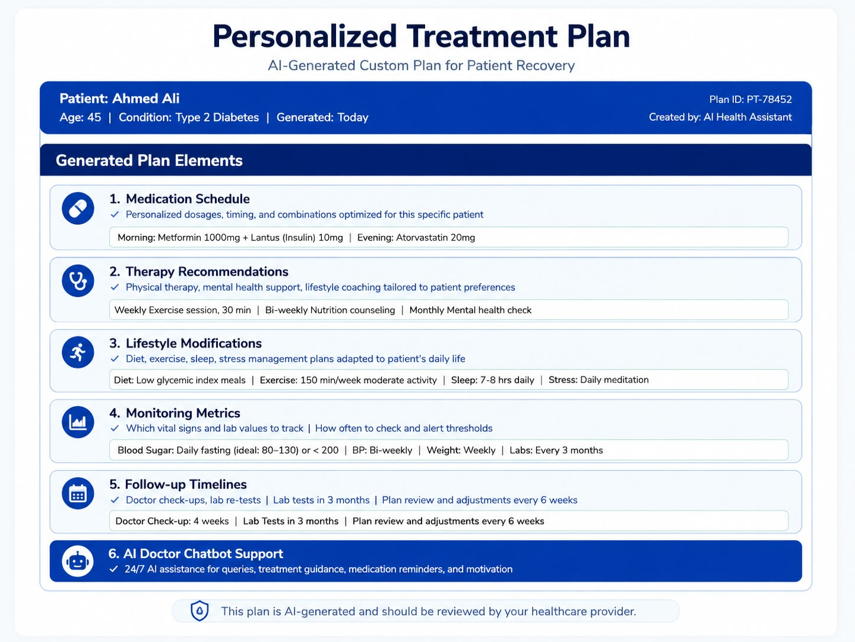
Personalized Treatment Plan
AI Generated Plans
Generated Plan Elements
• Medication Schedule
• Therapy Recommendations
• Lifestyle Modifications
• Monitoring Metrics
• Follow-up Timelines
[AI Doctor Chatbot Assistance]
[Treatment Plan
Visualization]

Slide 7
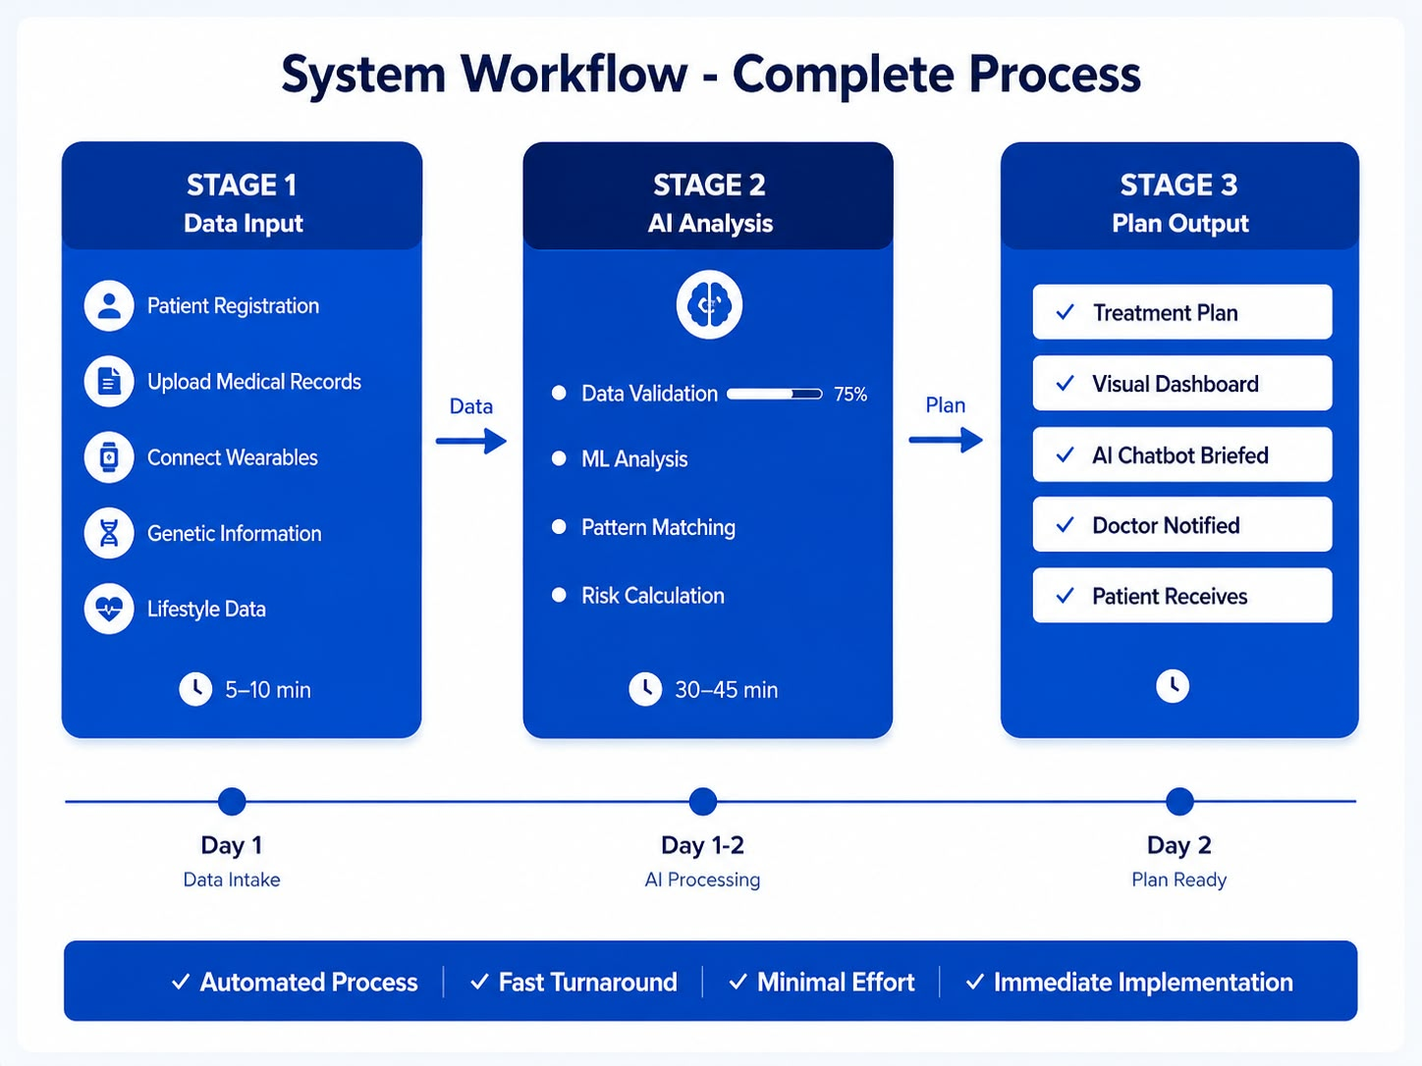

System Workflow
Complete Flow
[Data Input
Stage]
[AI Analysis
Stage]
[Plan Output
Stage]

Slide 8
Benefits & Impact
Real-World Impact
[For Healthcare]
✓ Faster Diagnosis
✓ Data-Driven Decisions
✓ Scalable Solution
✓ Quality Improvement
[For Patients]
✓ Personalized Care
✓ Better Outcomes
✓ 24/7 AI Chatbot
✓ Lower Costs

Slide 9
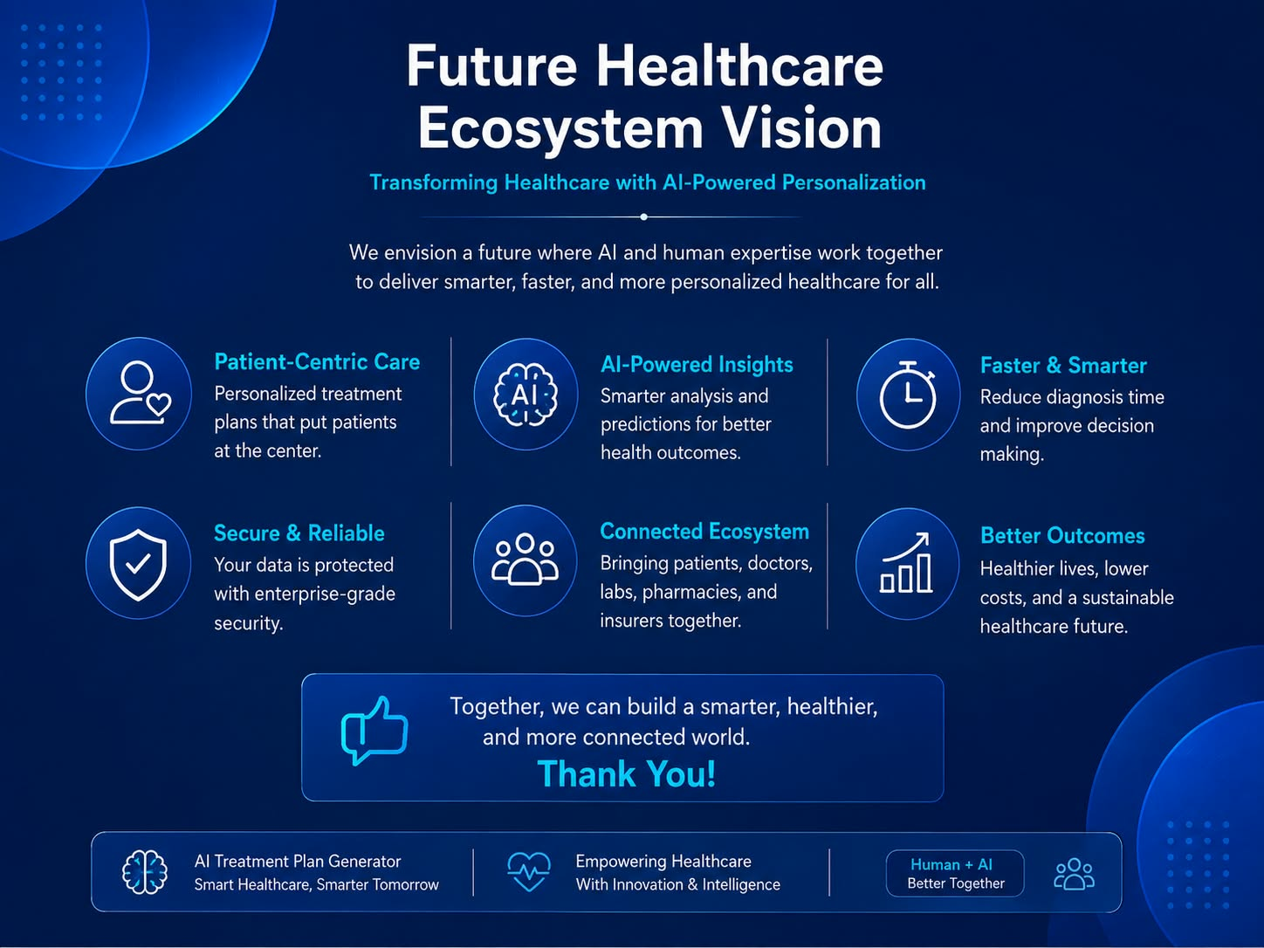
Future Vision
Transforming Healthcare with AI-Powered Personalization
[Future Healthcare
Ecosystem Vision]
Alibaba AI Hackathon | Healthcare Innovation

